Slide 1


DIARIES IN HOLOCAUST STUDY
Doane College
October 25 -26, 2015
PIECING TOGETHER A VIEW OF WHAT HAPPENED DURING THE HOLOCAUST

Slide 2
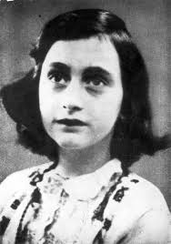
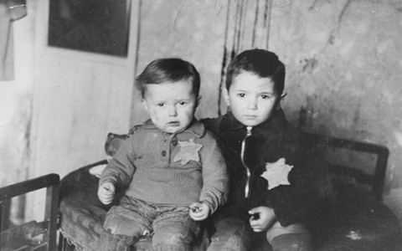
Diaries allow students to reflect on the most innocent of the innocent victims of the Holocaust – the children.

Slide 3
KNOW YOUR STUDENTS
SAFE IN – SAFE OUT
    Immigrant population with shared experiences
    Baggage a student may carry from their personal life

Slide 4
HISTORICAL/EDUCATIONAL AXES
The historical axis deals with teaching about the Holocaust itself - the "what" and "how" questions
The educational axis demands that the Holocaust be regarded not only as a historical narrative, but also as a human story.

Slide 5
DIARY VS. MEMOIR
DIARY – written without the knowledge of how the story ends
MEMOIR – written knowing the ending; the experience has been processed and edited
Notes:
Memoir not your life’s story – the story of your life.

Slide 6
GUIDELINES AND DIARIES
to see real people in the numbers of the Holocaust
to avoid romanticizing Holocaust history
to examine perspectives of victims, perpetrators, rescuers and bystanders
to contextualize parts of Holocaust history
to avoid comparison of suffering and pain
Notes:
Romanticize – not all Schindlers; not too much gore- develops cynics

Slide 7
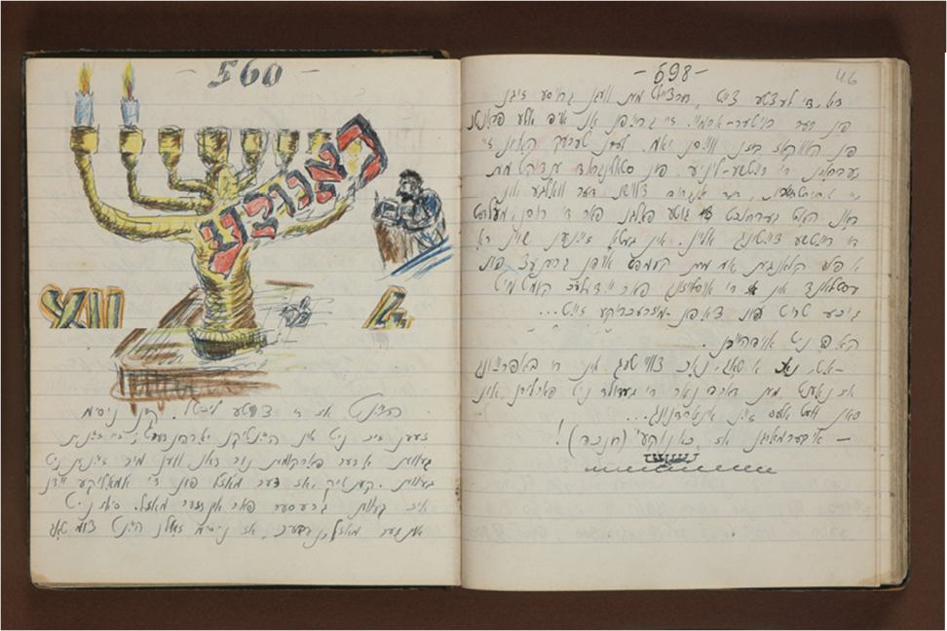
Salvaged Pages
“These writings capture the experience of young people from the inside—not as the Nazis decreed it, not as observers witnessed it, not as historians made sense of it after events occurred.” (Zapruder)
They wrote with:
  no knowledge of the outcome
They observed and recorded
    What they eat and how they dealt with hunger
    How they communicated.
    How they dealt with loss of home and family.
    How they continued to hope for a better future.
Notes:
Over the course of the next ten years, I gathered and researched more than sixty diaries written
by young people in occupied Europe. These writings capture the experience of young people
from the inside—not as the Nazis decreed it, not as observers witnessed it, not as historians
made sense of it after events occurred. They are records written without knowledge of the
outcome, as young people traveled through their daily lives, observing and recording as they did.
We, as historians, teachers, and students, mine them for historical information and find it in the
details. What did people eat? How did they communicate? What were their concerns? What were
their reprieves and joys? What surprises of daily life are contained within that we might not
assume or imagine from our perspective 60 years or more into the future?

Slide 8

“Through these boys’ and girls’ writings we learn about the external realities of children’s wartime lives as well as their inner most thoughts and feelings.”
Laurel Holliday
Grouped by age
Shorter selections
Photos of some of the diarists
Map to show where each diarist lived

Slide 9
USE THE STUDY OF DIARIES AS AN ANALYSIS OF DIFFERENT WARTIME EXPERIENCES
exile
hiding
ghetto life
Notes:
Exile – legal (dealing with bureaucracy)and illegal (physical dangers, risks, fear)
Hiding – in the open with false identity, the Franks, Ephriam Shtenkler in a cupboard
Ghetto life – majority of diaries were written in the ghettos of Europe

Slide 10
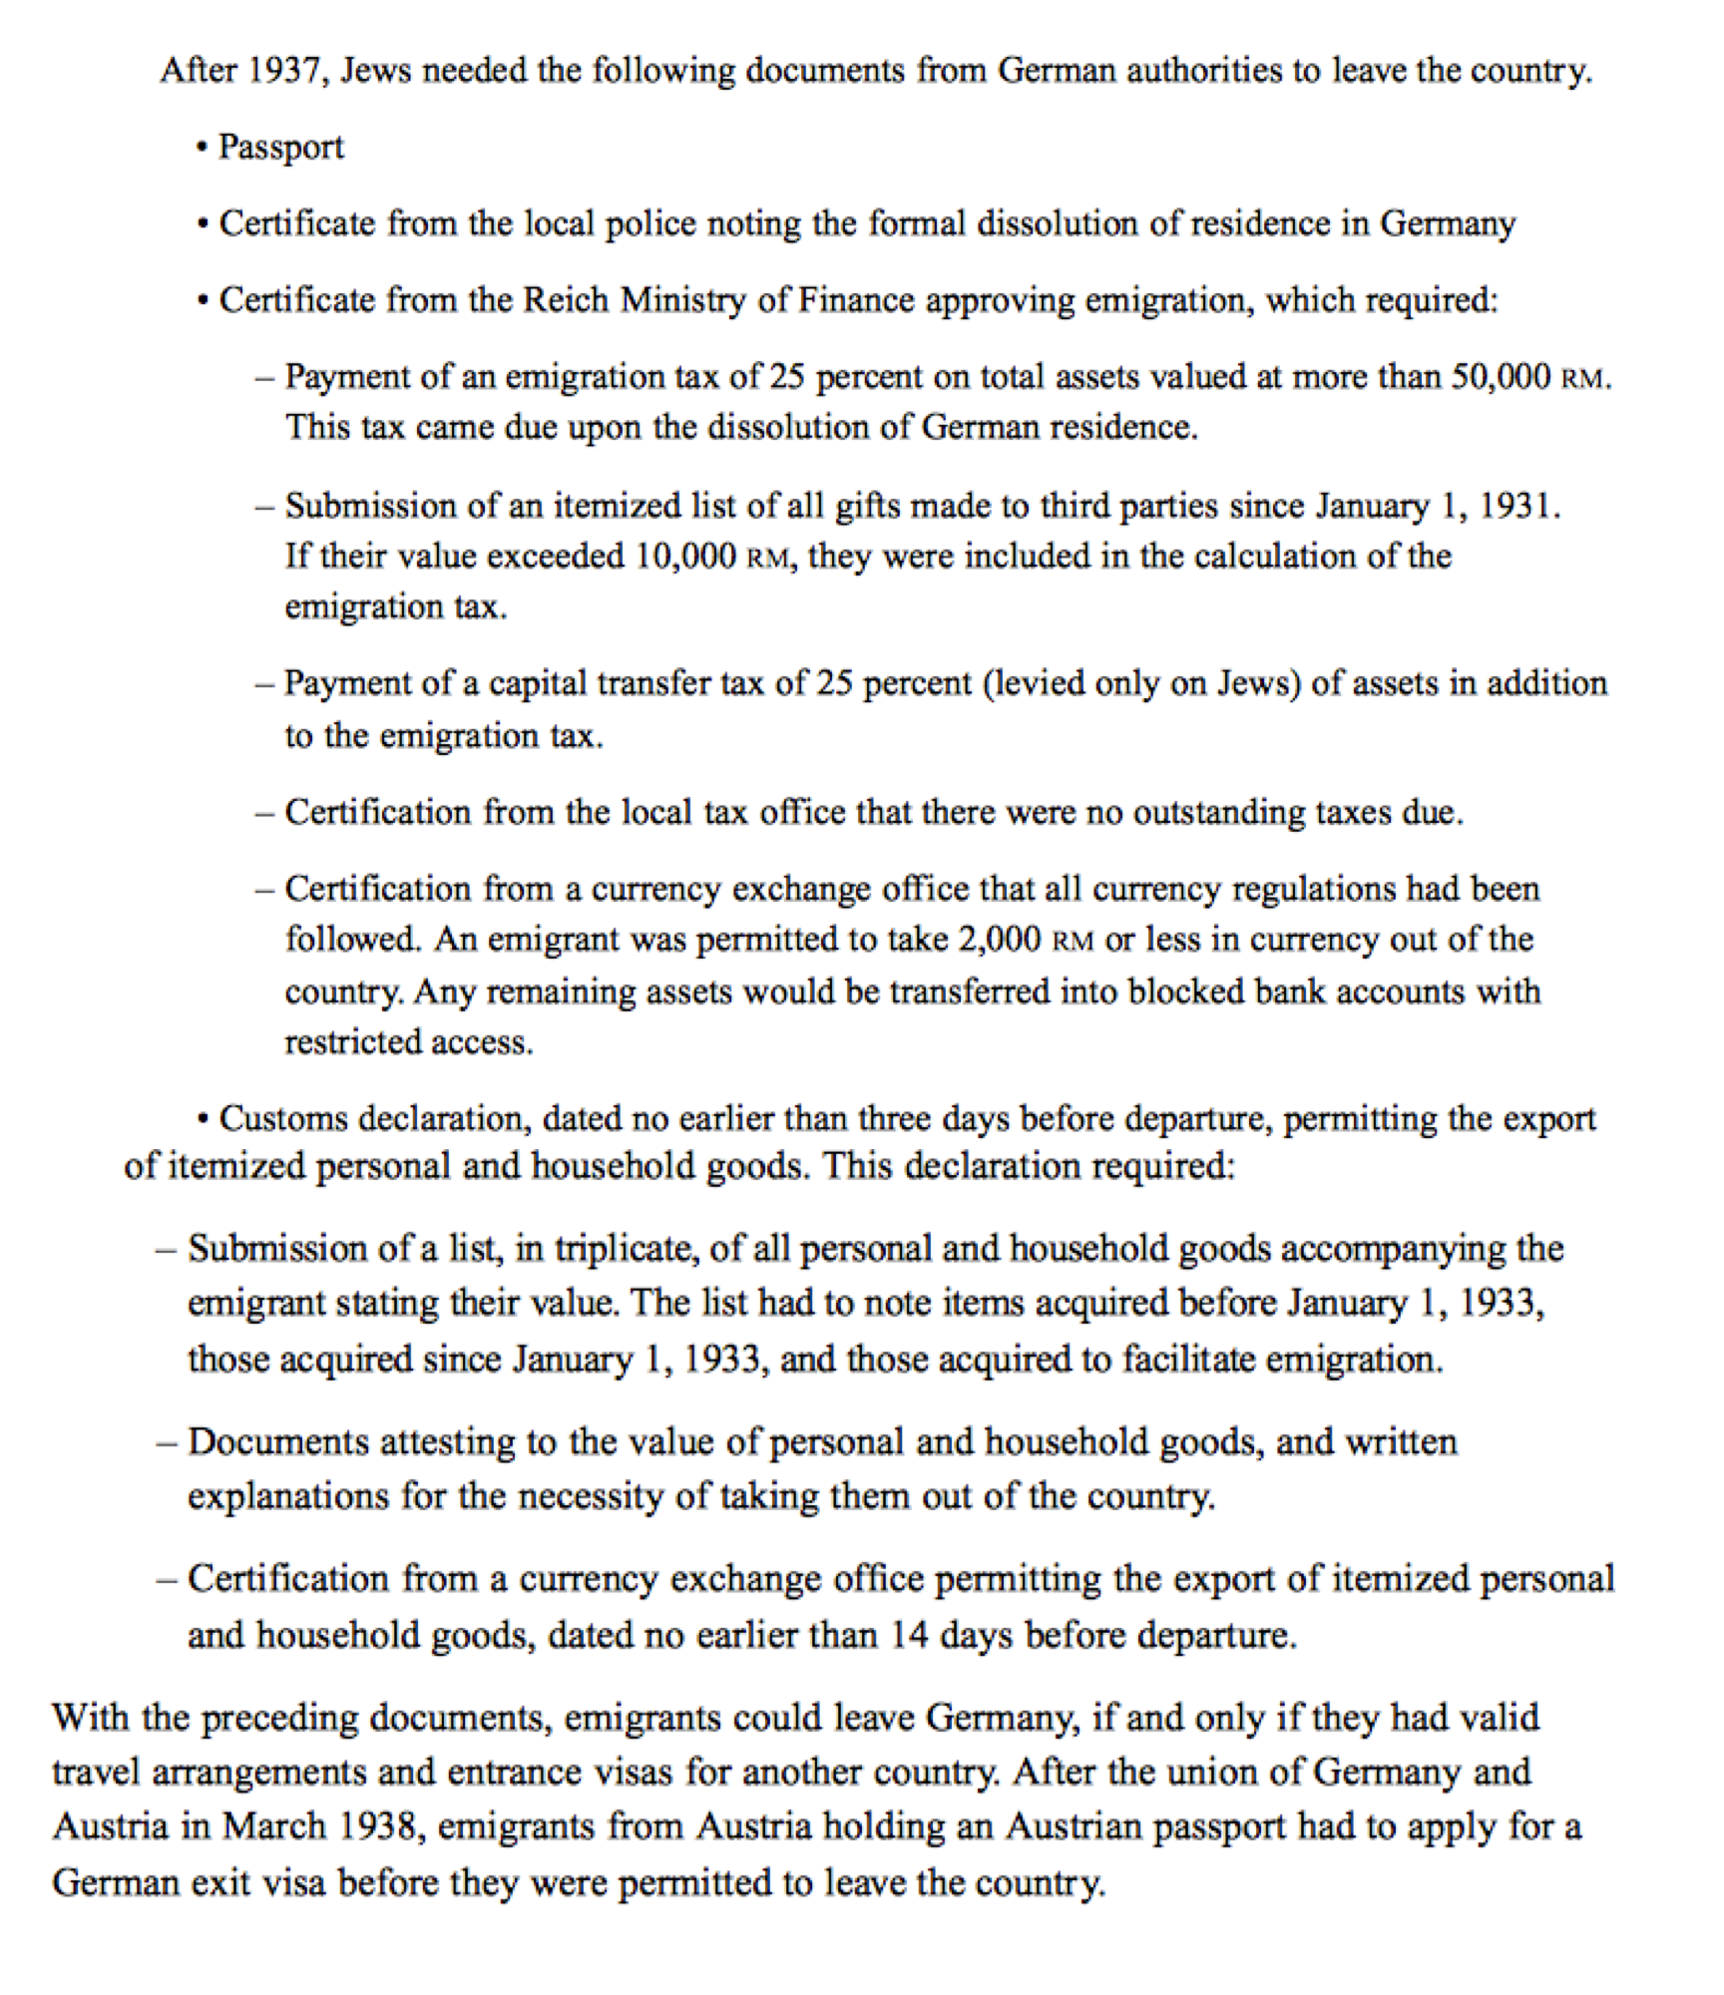

Slide 11
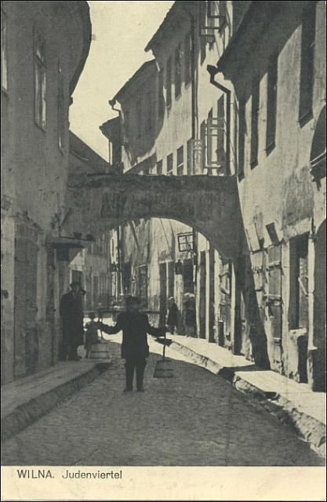
DIARISTS ARE NOT HISTORIANS
A GIVEN PLACE
A GIVEN TIME
IN A GIVEN SET OF CIRCUMSTANCES
INSIGHTFUL, DETAILED, COMPLEX AND CONTRADICTORY

Slide 12
TWO APPROACHES TO DIARIES
Historical
  Look for answers to questions
  Find common threads or themes
  Not strictly accurate or historically objective
Literary
  Genre/voice/purpose
  Touch on the truths of human experience
  Writing was the quickest and best way to share his or her experiences.
Notes:
Not historians but eyewitnesses to history.

Slide 13
APPROACH THROUGH “WORLDS”
Internal world – reflecting
  thoughts and feelings
Immediate world – reporting
  detailing events
External world – chronicling
  as it happened to their community
  ALEXANDRA ZAPRUDER

Slide 14
WHY WRITE?
To “set things right”; to be accountable to oneself for time, conduct , or character
To confide private thoughts or feelings
For parents or loved ones, to feel closer to those far away
Expressing despair about the purpose of writing, yet the need prevails
For the public, as a testimony to those who were not there

Slide 15

Study guide for I’m Still Here
I’m Still here

Slide 16
DIARIST | ENTRY DATE | ENTRY SUBJECT | WARTIME EXPERIENCE | THEME/TOPIC
Klaus Langer | December 19, 1938 (page 24) | difficulties and obstacles in emigration from Germany | refugee: legal emigration | in exile: beaurocratic impediments to emigration
Elisabeth Kauffman | June 9 and June 11, 1940 (pages 55-56)
Peter Feigl | May 22, 1944 (pages 88)
Otto Wolf | June 24, 25: July 4; August 2, 1942 (page 130)
Moshe Flinker | January 7 and 13, 1943 (page 110-111)
Anonymous Girl, Lodz Ghetto | February 27, 1942 (page 231) |  | Lodz Ghetto: sealed ghetto in Poland
Miriam Kober | January 12, 1942 (page 257) |  | Djurin: unsealed ghetto in Transnistria (Romanian Jews)
Ilya Gerber | August 31, 1942 (page339 -40) |  | Kovno Ghetto: sealed ghetto in Lithuania
Yitskok Rudashevski | January 7, 1943 (page 219-220) |  | Vilna ghetto: sealed ghetto in Lithuania

Slide 18
Enhancing diary study
Read several diary selections
Use film clips to increase understanding
Use maps to understand the scope of the Holocaust
Create timelines to place the diarist in the context of Holocaust history
Use ancillary resources to build understanding

Slide 19
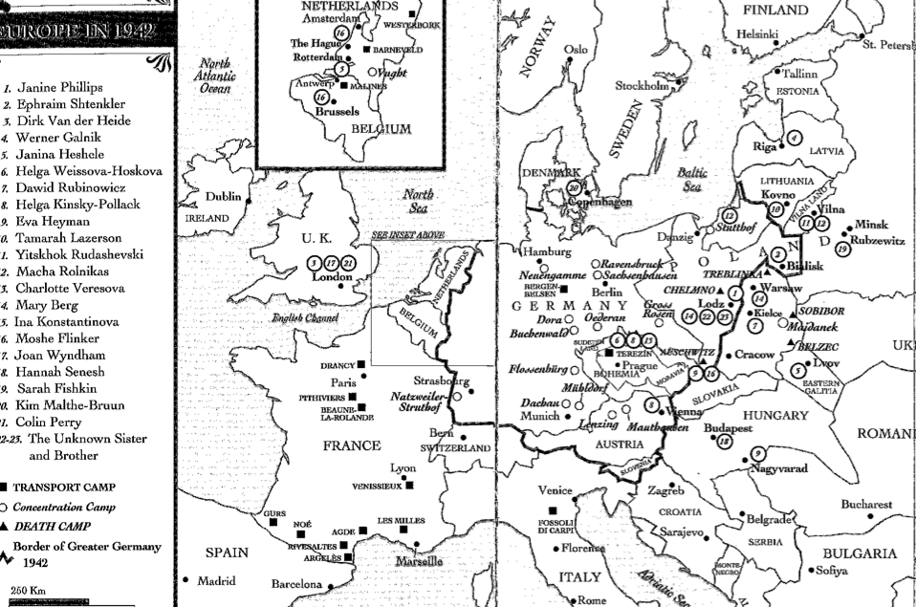

Slide 20
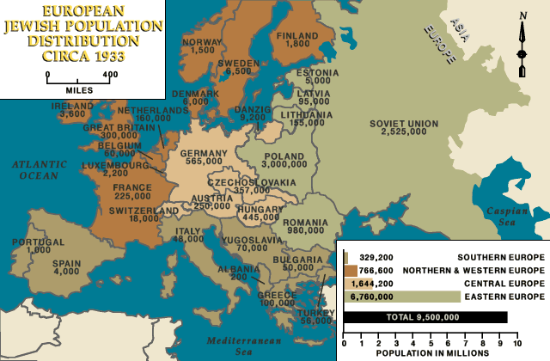
European Jewish Population 1933

Slide 21
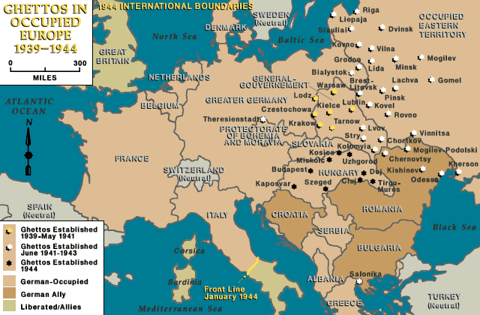
GHETTOS IN OCCUPIED EUROPE
Notes:
The researchers have cataloged some 42,500 Nazi ghettos and camps throughout Europe.

Slide 22
TIME LINE HELP FROM I AM STILL HERE
1940
•
The Nazis begin deporting German Jews to Poland. Jews are forced into ghettos.
•
Germany conquers the Netherlands, Denmark, Norway, Belgium, Luxembourg, and
France.
•
The Nazis begin the first mass murders of Jews in Poland.
February 1940, Peter Feigl begins his diary in France.
February 1940, Elisabeth Kaufmann begins her diary in France.
March 21, 1940 Dawid Rubinowicz begins his diary in Krajno, Poland.

Slide 23
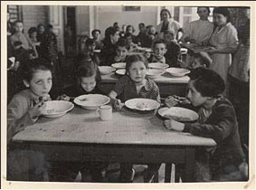
Interactive Website at Yad Vashem

Slide 24
Pre-war Photos
Looking at the individual

Slide 25
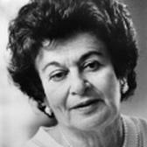
GERDA WEISSMAN KLEIN ON ANTISEMITISM

